Slide 1
Predicting Song Popularity Using Logistic Regression
Tasnia Kader
Course: CIS 3715
Professor: Dr. Hongchang Gao

Slide 2
Objective
Predict whether a song will be popular or not based on its features
Use binary classification model: logistic regression model

Slide 3
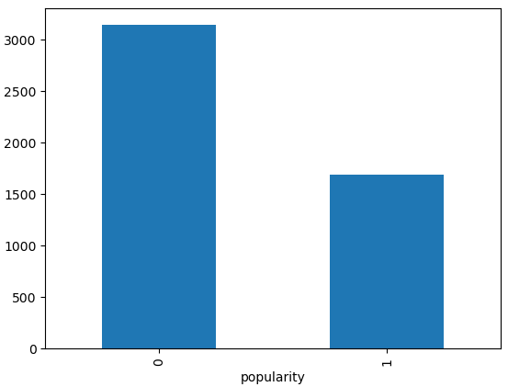
Description of Data
# column 0 energy 1 tempo 2 danceability 3 genre 4 loudness 5 valence 6 artist 7 speechiness 8 instrumentalness 9 mode 10 key 11 duration 12 acoustiness 13 subgenre 14 popularity
Data Obtained from Kaggle
Audio & Descriptive Features (14)
4831 entries
Imbalanced
High Pop : 1
Low Pop : 0

Slide 4
Model
Logistic Regression Model with L2 (Ridge) Regularization
Train 90%, Test 10%
9-fold Cross-Validation
Hyperparameter Selection from [1000, 100, 10, 1, 0.1, 0.05, 0.02, 0.01]
Chose best hyperparameter based on best avg f1 score

Slide 5
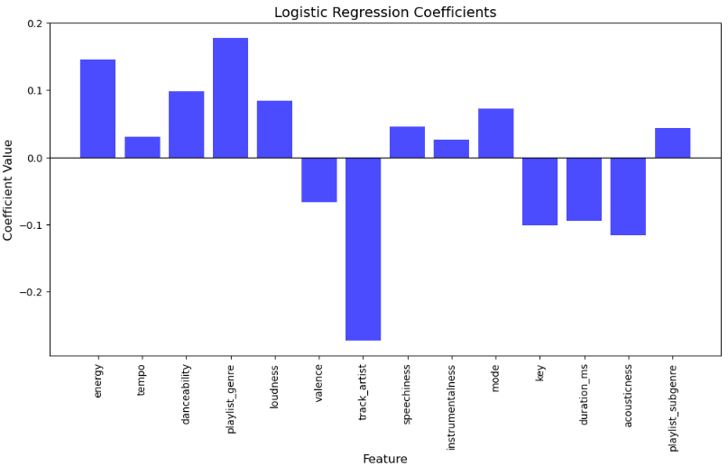
Results
Best hyperparameter: 100
F1-score: 0.824
Recall: 0.835
Precision: 0.813
Least Relevant Feature: instrumentalness, tempo
Most Impactful Feature: artist, genre, energy

